Slide 1

WOTS
Time Slot Program
BCS120- Term Project
‘21 Spring Semester
Team 1-
Hadia Majed, Bruce Alarcon, Kevin Jin, Fatima Ali, Raheel Iqbal

Slide 2


Our Roles
Algorithms: Raheel Iqbal
Coding: Kevin Jin, Hadia Majed, Raheel Iqbal
Flowchart: Fatima Ali
Powerpoint: Bruce Alarcon

Slide 3


What does our program do?
“Word on The Street” (WOTS), is our broadcasting station where we allow clients to purchase time slots for their own purpose.
Clients will be able to book and purchase their time slot for a month in advance.

Slide 4
Program Demo
Login with Customer ID, 64735 and PIN, 5102
Objectives
Purchase a time slot
Get receipt and confirmation of purchased slot

Slide 5
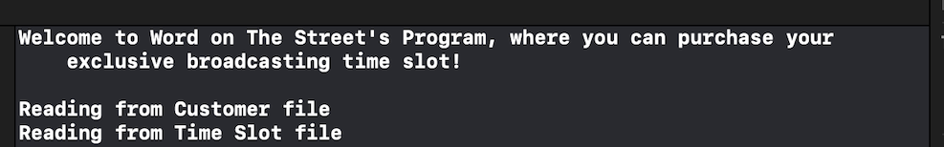
Welcome

Slide 6
Login

Slide 7
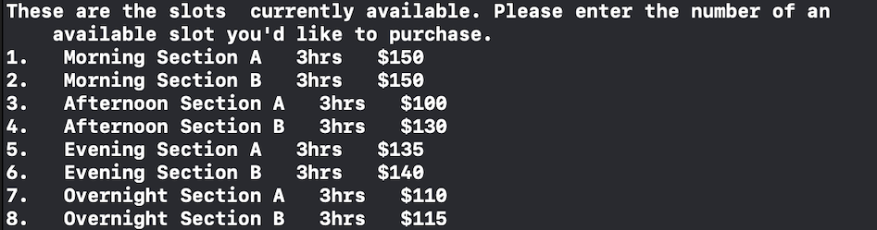
Displaying All Time Slots

Slide 8
Selection of Time Slot

Slide 9
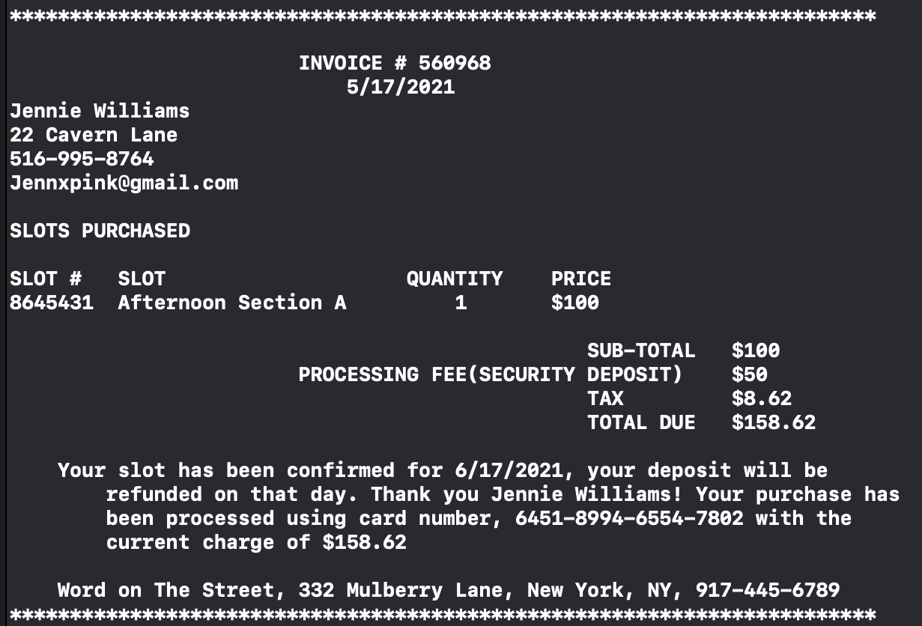
Receipt/Invoice of Purchased Time Slot

Slide 10

Any Questions?

